Slide 1


Slide 2
Weekly Updates
Please provide a quick update on either:
Something you did/saw this week that you thought was interesting
What you’re looking forward to about this week’s workshop
(Reminder - please have your cameras on if possible)

Slide 3
Workshop 2
Data Exploration & Extraction

Slide 4

Sessions Overview
Workshop 1 – Project Introduction & Setup
Workshop 2 – Genomic Data (A2 Assignment)
Workshop 3 – Data Analysis & Visualization (A3 Assignment)
Workshop 4 – Featurization & Baseline Modeling (A4 Assignment)
Workshop 5 – Model Training Approaches (Final Assignment Set)
Workshop 6 – Model Tuning
Workshop 7 – Performance Evaluation (Final Assignment Code/Testing Due)
Workshop 8 – Results Presentation & Wrap up (Final Presentation Due)

Slide 5
What can be Measured?

Slide 6
Research Question
Gene A
Bacterial Genome
Remembering back to last week:
Aiming to predict AMR directly from genomes
Bacterial genomes are relatively small
Plasmids
Genome is Circular
Gene B

Slide 7

Research Question
Gene A
Bacterial Genome
Plasmids
Genome is Circular
Remembering back to last week:
Aiming to predict AMR directly from genomes
Bacterial genomes are relatively small
For our supervised learning task we need two sets of information:
Y labels: ground truths
X data: feature matrix
Gene B
Data
Prediction
True Labels
Model
?
x11, x12, ..
x21, x22, ..
..
w1
w2
..
y’1
y’2
..
y1
y2
..
=
?
[2]

Slide 8
Research Question
Gene A
Bacterial Genome
Plasmids
Genome is Circular
Remembering back to last week:
Aiming to predict AMR directly from genomes
Bacterial genomes are relatively small
For our supervised learning task we need two sets of information:
Y labels: ground truths
X data: feature matrix
Two main areas we need to investigate:
How do we measure antibiotic resistance?
What features can we extract from the bacterial genomes and how?
Gene B
Data
Prediction
True Labels
Model
?
x11, x12, ..
x21, x22, ..
..
w1
w2
..
y’1
y’2
..
y1
y2
..
=
?
[2]

Slide 9
AMR Profiling

Slide 10

Antimicrobial Resistance
There are a number of methods for testing AMR in bacteria but the one we’re going to focus on is “Broth dilution”
What concentration of antibiotic prevents bacteria from growing?
Steps:
Generate multiple concentrations of antibiotic in individual tubes (doubling dilutions)
Add bacteria into each tube
Monitor growth over time and determine what concentration stops growth
This concentration is the:
Minimum Inhibitory Concentration
Drug concentrations
Increasing Antibiotic
0.5
1.0
2.0
4.0
8.0
16.0
No Bacterial Growth
MIC = 8.0

Slide 11
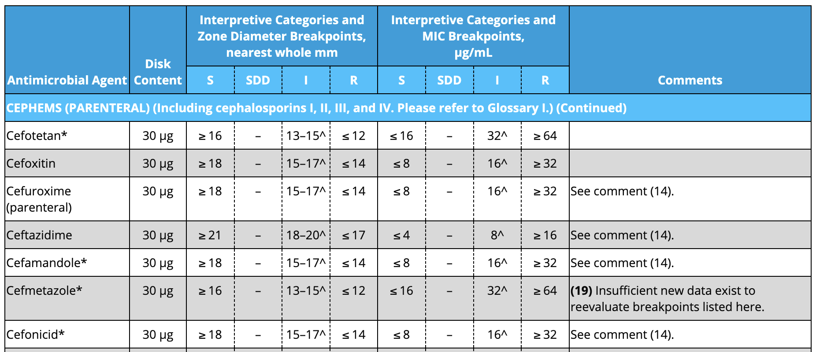
Resistance Overview
So we have a Minimum Inhibitory Concentration (MIC)
Resistance and Susceptibility is defined by governing bodies (in the US this is the NCBI)
CLSI publishes the M100 each year - this free resource contains a translation between MIC for each bacterial species/drug to a canonical resistance call:
R = Resistant to the drug, not recommended for use
I = Intermediate, shows some resistance, not recommended for use
S = Susceptible, drug will be effective against organism
Often R & I are grouped together into “Not Susceptible”
Example Table from M100
[1]

Slide 12
Genomic Sequencing

Slide 13
QUIZ TIME !?
What data are we trying to measure with sequencing?
The number of cells in the organism
The amino acid sequences and proteins of the organism
The size of the bacteria from smallest to largest
The nucleotide sequences of the organism

Slide 14
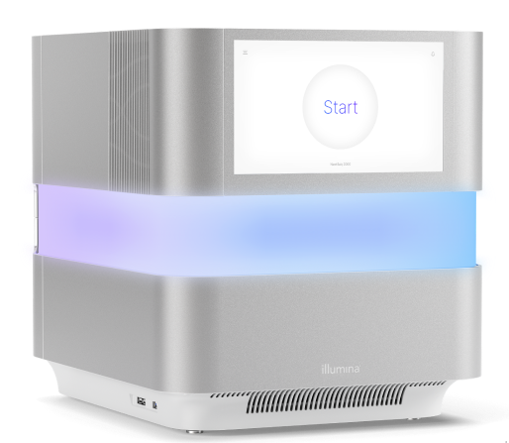
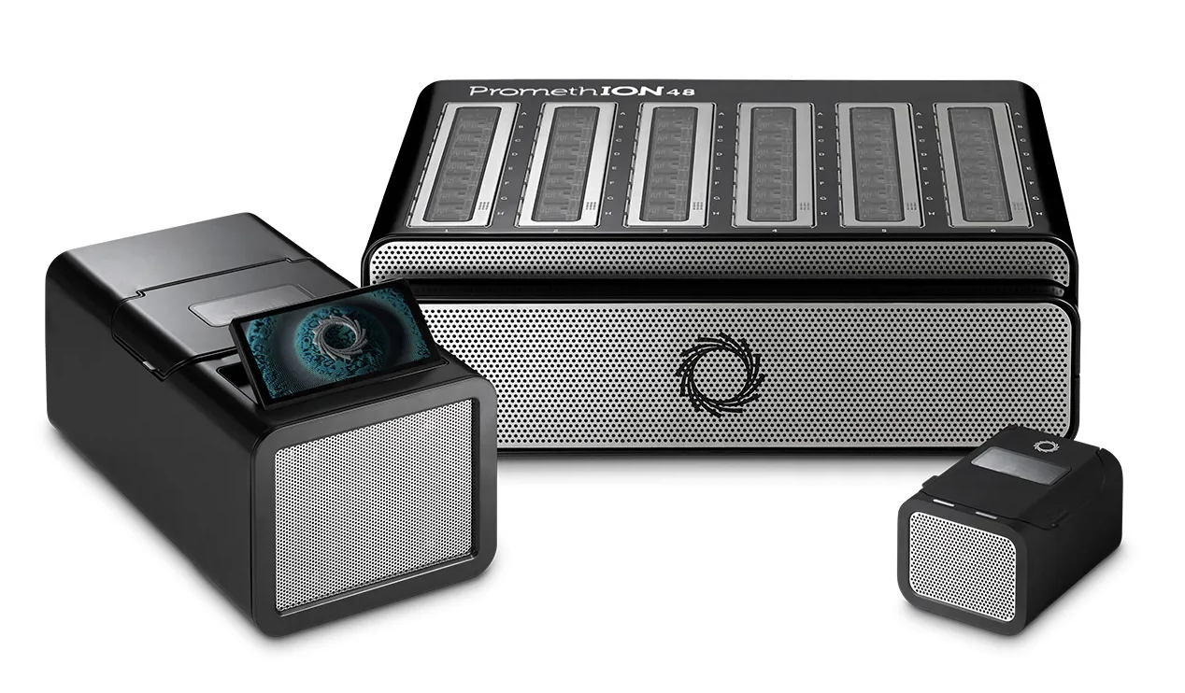
Long Read vs Short Read
Illumina Sequencer
Sequencing technologies have evolved rapidly over the past few decades and continue to do so now.
Currently two state of the art methods for sequencing genomes split into two categories:
Short read (e.g. Illumina [2])
Long read (e.g. ONT [3])
Steps are similar:
Chemically extract and amplify the DNA of the bacteria
Prepare the DNA for sequencing (insertion of adaptors and other synthetics sequences)
Run through the sequencer and record the resulting bases
We’ll focus on short read data for this project as it’s more available and common
[4]
ONT Sequencer
[5]

Slide 15
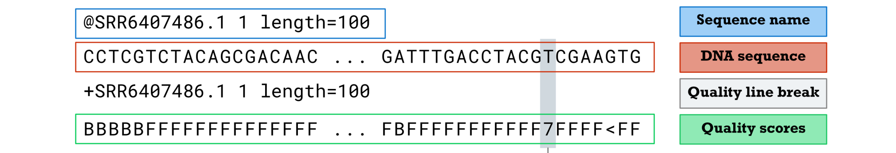
Short Read Data
Genome is Circular
Short read sequencers build segments of of the DNA that are inherently small in length (typically 50-300 nucleotides)
This is very small compared to our bacterial genome (2-6 million nucleotides).
We’re going to end up with millions of tiny chunks of DNA
FASTQ:
FASTA:
FASTA is identical to the above but without the quality information
[6]
DNA “Soup” - Where are the Genes?

Slide 16
Where can we Find Data?

Slide 17
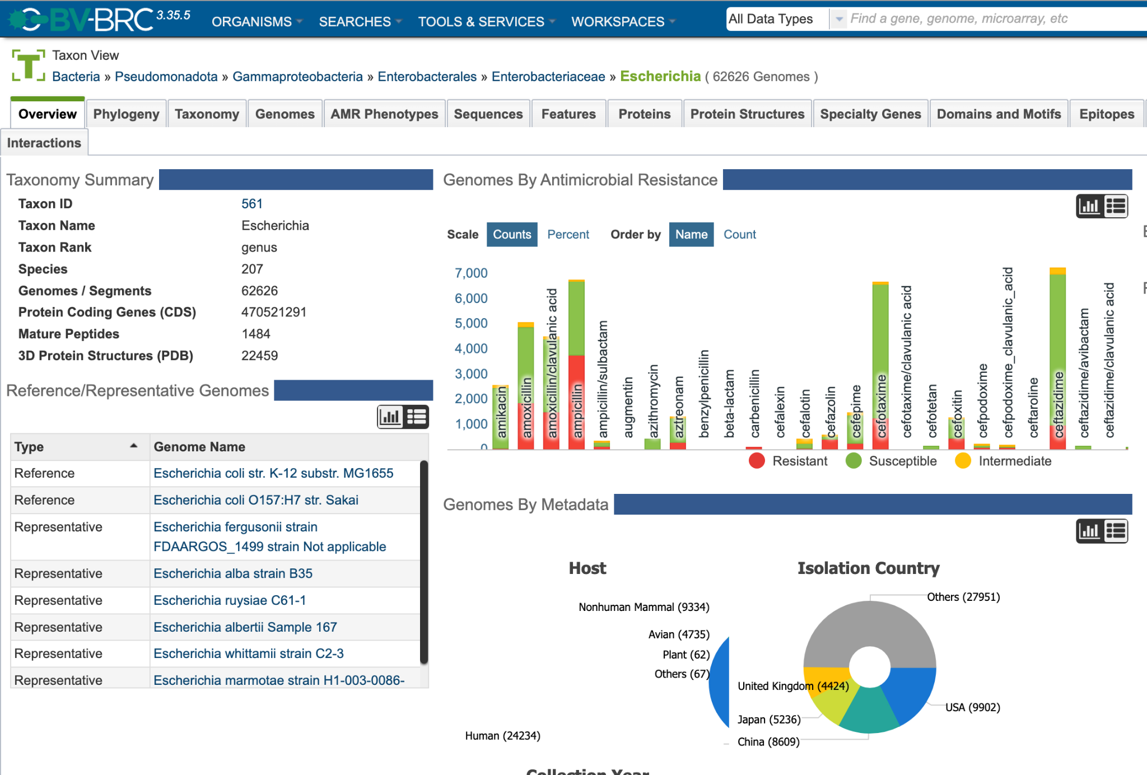
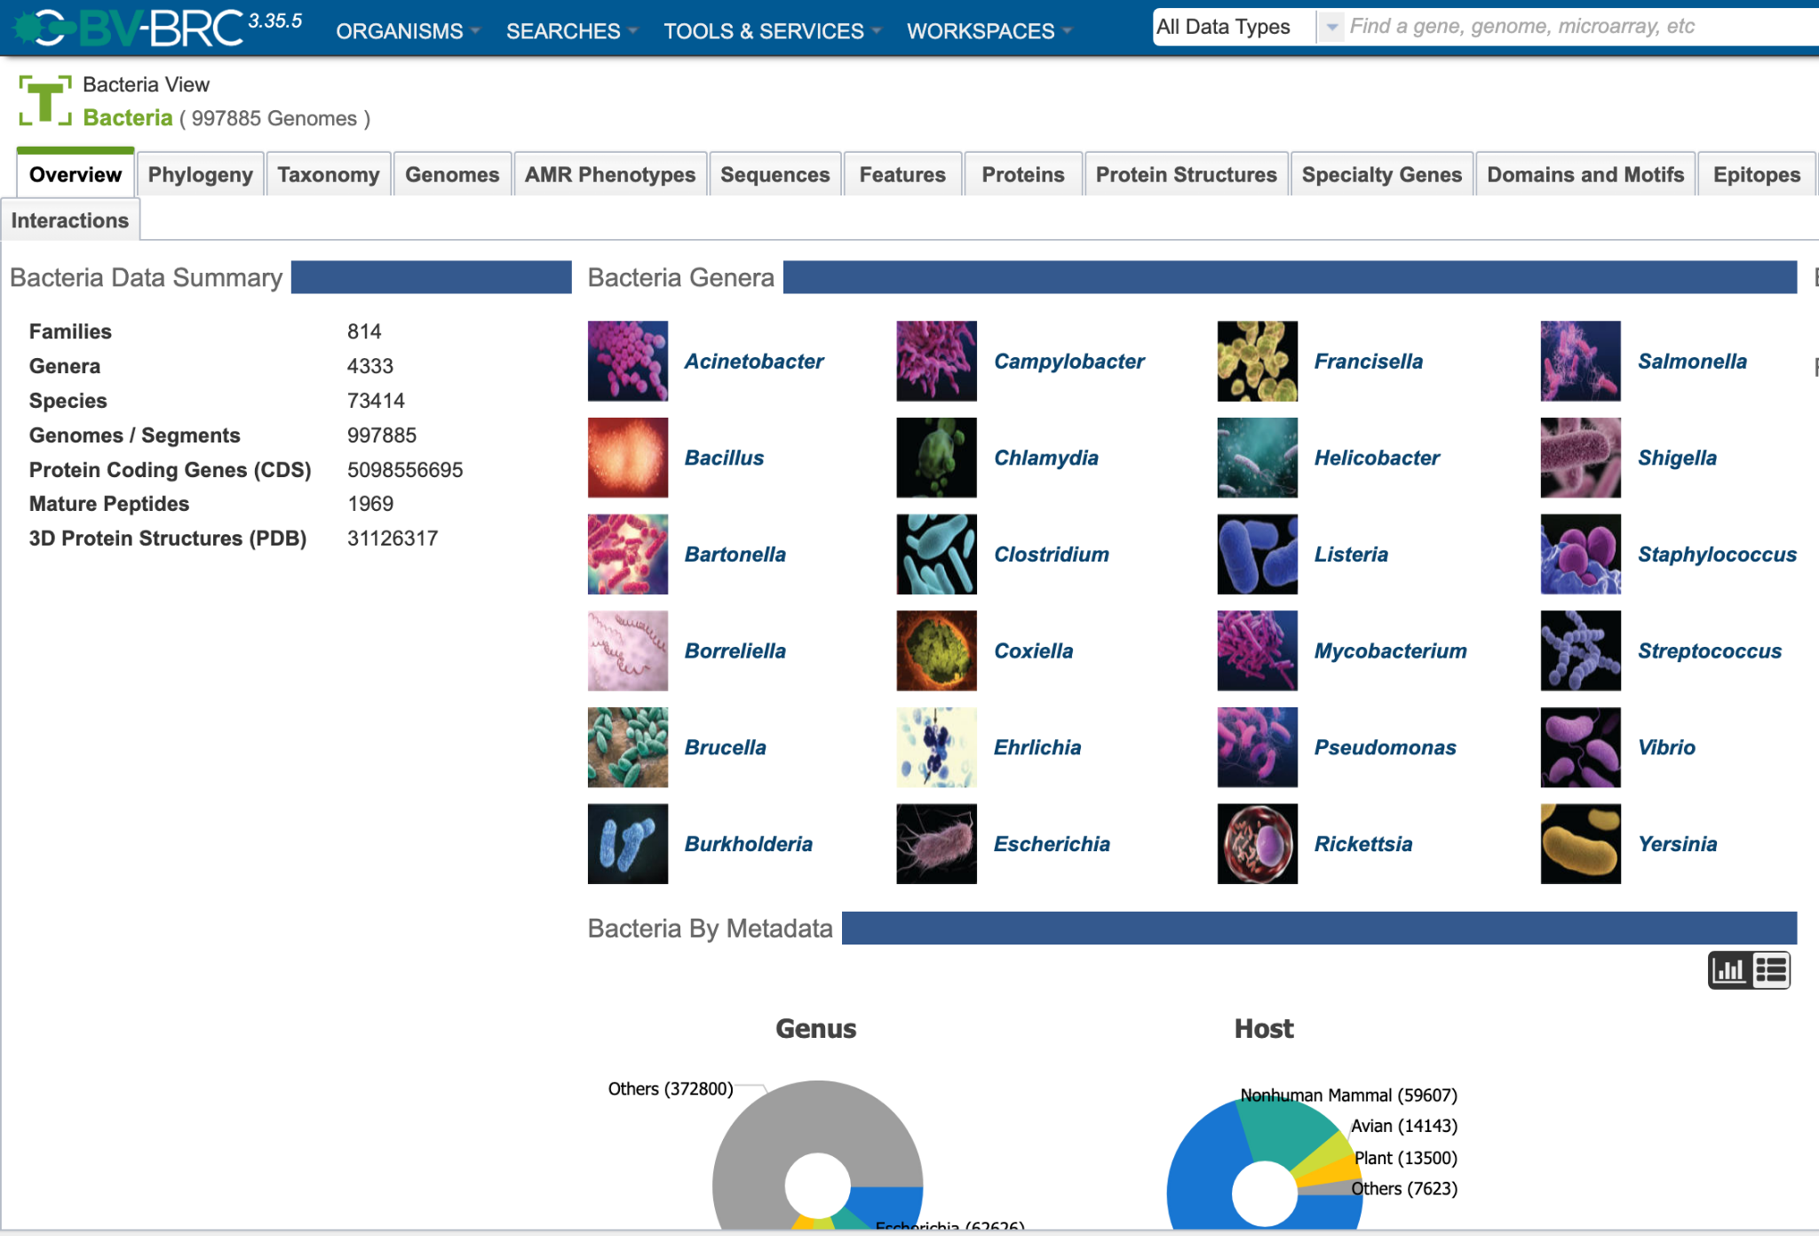
Public Data Sources
Bacteria and Viral Bioinformatics Resource Center (BV-BRC) [7]
Online database of bacteria (and viruses) with large amount of metadata around each sample
Importantly many strains come with AMR test results
Assembled Data
For this course we’re going to be working with “Assembled” data
Assembly is a bioinformatic technique to take the millions of short reads and align them to themselves
Using overlapping regions the reads can be stitched back together
Still not a full single circular genome
Fewer pieces to work with and higher quality!

Slide 18
Data Preprocessing

Slide 19
Genes & Alignment
A perfectly assembled bacterial genomes can be anywhere between 2 million and 6 million nucleotides
That’s a very long string!
We certainly could try working with the whole sequence but it might prove computationally difficult
Instead we can try to subset the genome down to just areas we care about
In this case: Known Resistance Genes
This will introduce biases - we are throwing away much of the genomic sequences but it will allow us to achieve a predictive model in a reasonable time frame
If we had a list of important genes (toy example):
CGTATAACTGA
GGAACAGCGGT
Can we search for them in each sample?
CGTATAACTGA
GGAACAGCGGT
AACGTATAACTGATCGGAACAGCGGTA
Assembled Sample Genomes (toy example)

Slide 20
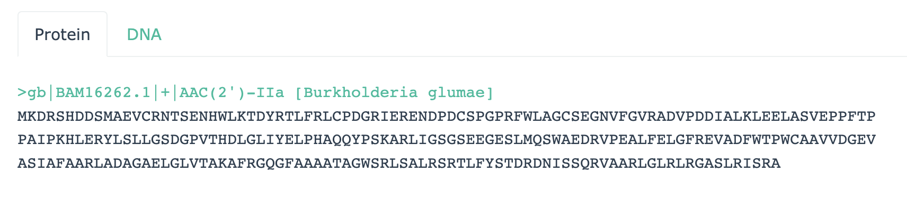
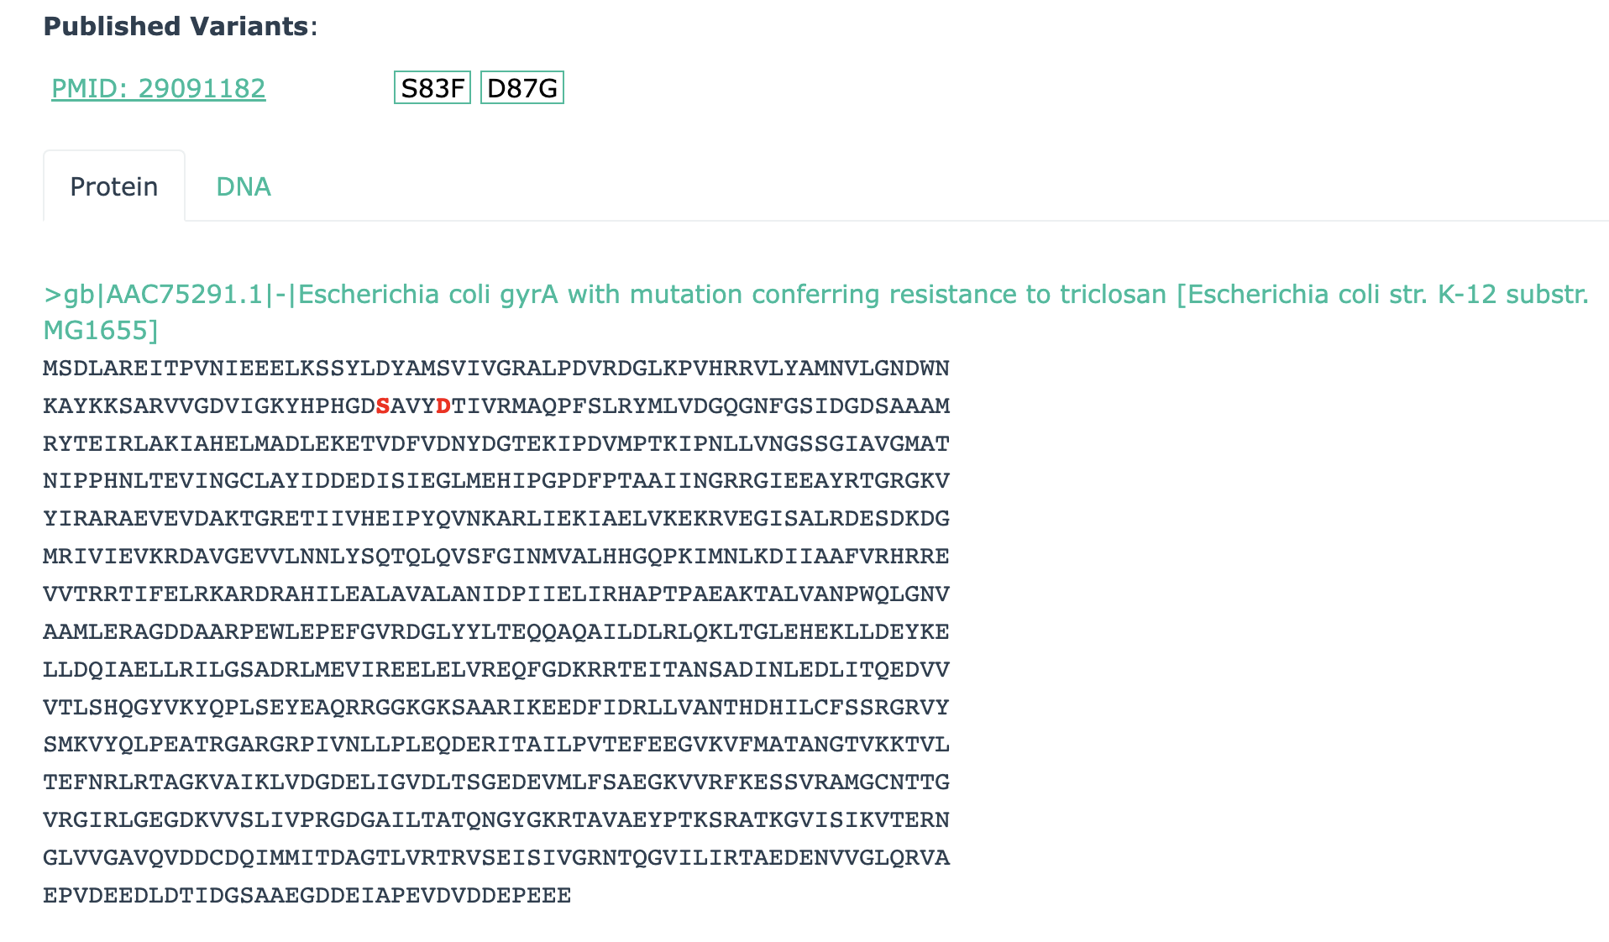
CARD
Presence/Absence Gene
So where can we gather our set of important genes?
Comprehensive Antibiotic Resistance Database (CARD) [8]
Two main types of resistance genes:
Presence/Absence (if exists then R)
Variant (if mutation in sequence then R)
Comes in FASTA format:
Header = Gene name + ID
Body = DNA string (or Protein string)
We’ll work with the DNA FASTA format
Variant Gene (variants highlighted in red)

Slide 21
Workshop 2
Data Exploration

Slide 22
References
[1]:https://em100.edaptivedocs.net/Login.aspx?_ga=2.87309720.1855123465.1712506668-1848165892.1711849752
[2]:https://www.illumina.com/science/technology/next-generation-sequencing/sequencing-technology.html#:~:text=The%20Illumina%20semiconductor%20sequencing%20method,high%20data%20accuracy%20of%20SBS.
[3]:https://nanoporetech.com/platform/technology
[4]:https://www.illumina.com/systems/sequencing-platforms/nextseq-1000-2000.html
[5]:https://nanoporetech.com/products/sequence/promethion
[6]:https://gencoded.com/index.php/2020/05/20/fastq-format-an-overview/
[7]:https://www.bv-brc.org/
[8]:https://card.mcmaster.ca/

